Slide 1

OpenGL ES Entering the 3D With Colors Chapters 4 & 6
Eng. Basma Hassan
Eng. Samar Shaban

Slide 2
3D in OpenGL ES 2.0
Drawing 3D objects is typically the same as 2D objects.
Only depth buffering should be enabled.

Slide 3
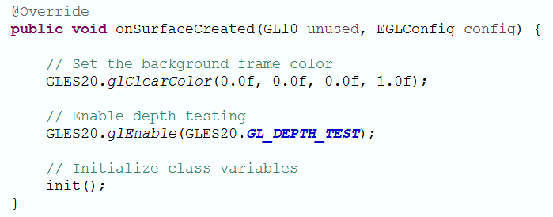
Renderer (Depth Buffering)
Our defined method

Slide 4
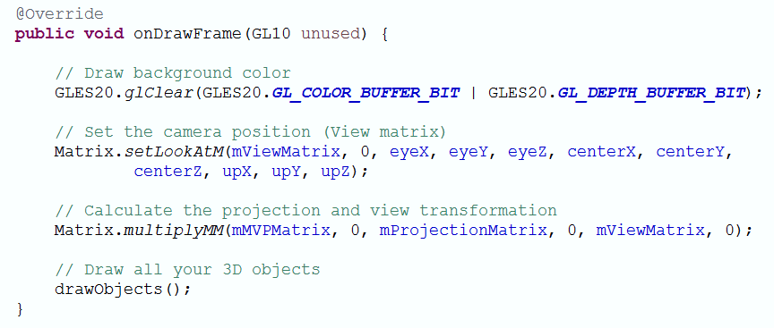
Renderer
Our defined method

Slide 5
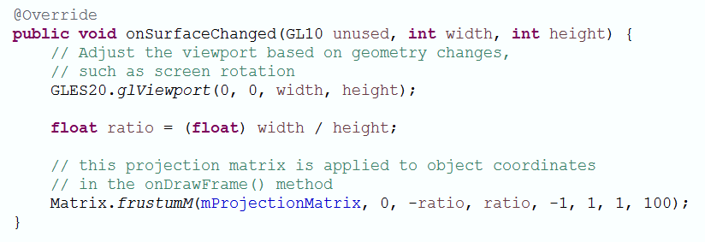
Renderer

Slide 6
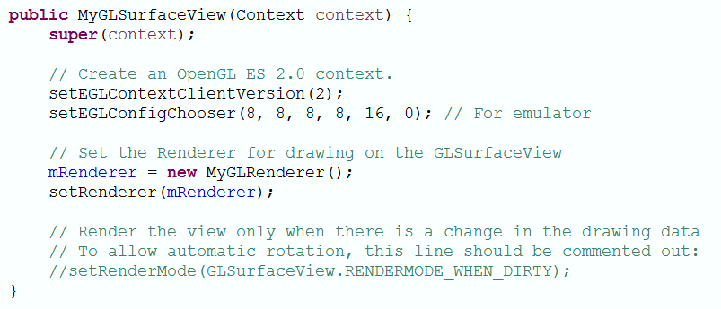
Continuous Rendering
Default is:
“GLSurfaceView.RENDERMODE_CONTINUOUSLY”

Slide 7
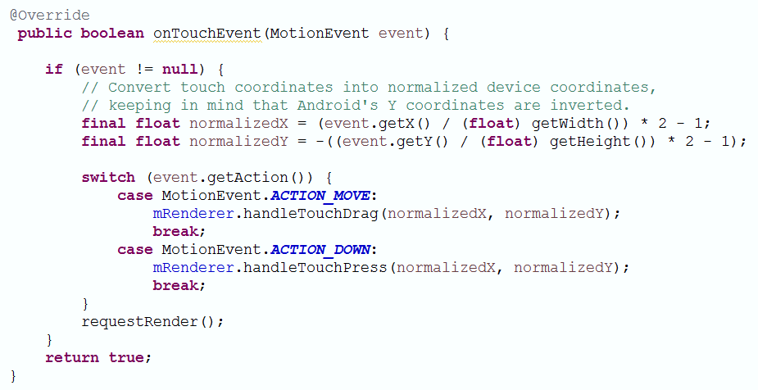
Handling Touch Events: (Press & Drag)
Our defined methods

Slide 8
What we are going to do…?
Drawing two cubes placed along the Z-axis.
Each face of the cube should have different color.
The front cube should rotate automatically around Y-axis.
Dragging/Sliding should:
Change the rotation axis (X, Y, or Z-axis)
Move the camera (Up, Down, or Forward)

Slide 9

Cube
Up
Left
Right
Y
Back
Front
X
Z
Bottom

Slide 10
Cube From Different Views
Y
Y
Z
X
X
Z
-Z
Front View
Back View

Slide 11
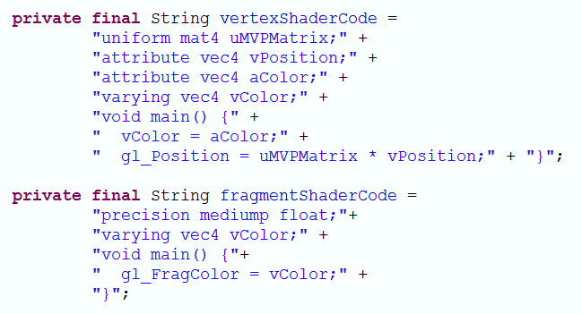
Use Various Colors

Slide 12
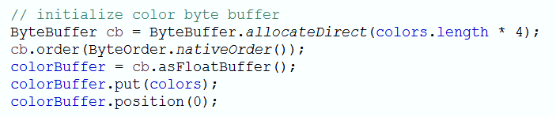
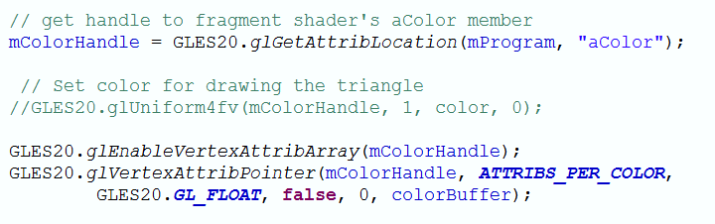
Cube Class
In Constructor
In Draw
X

Slide 13

Time for programming skills….
Let’s brainstorm together, How
can we do this task??!

Slide 14

See you Next Lab

